Slide 1
RL seminar
Boyeon, Kim
23.10.26

Slide 2

Done List
SLIAR
Reward design check
Reward = `- I`
Reward = `-I – penalty`
Penalty = sum(nus) – ${ν_{total}}_{max}$

Slide 3

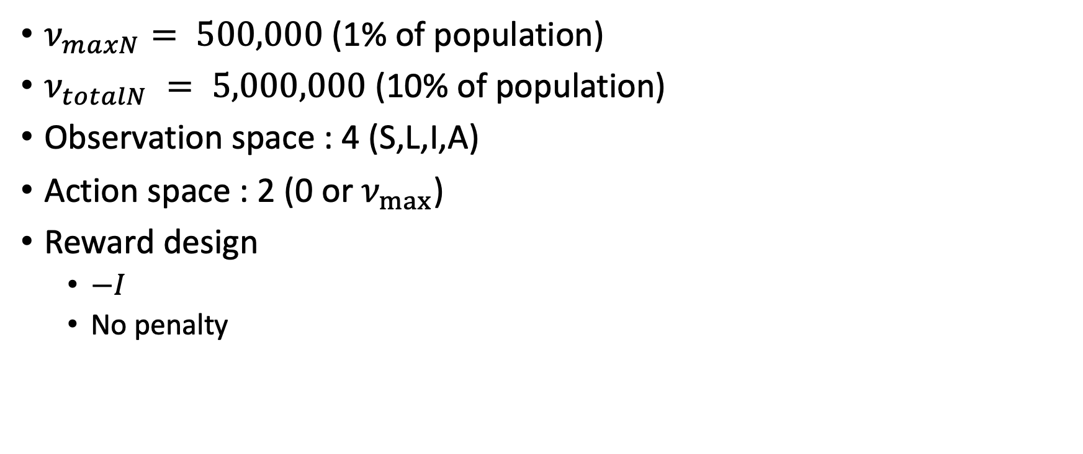
Set the environment for DQN in SLIAR
Reward : $`−I`$
$ν_{maxN}⁡= 500,000$ (1% of population)
$ν_{totalN} = 5,000,000$ (10% of population)
Observation space : 4 (S,L,I,A)
Action space : 2 (0 or $ν_{max}$)
Reward design
$−I$
No penalty

Slide 4
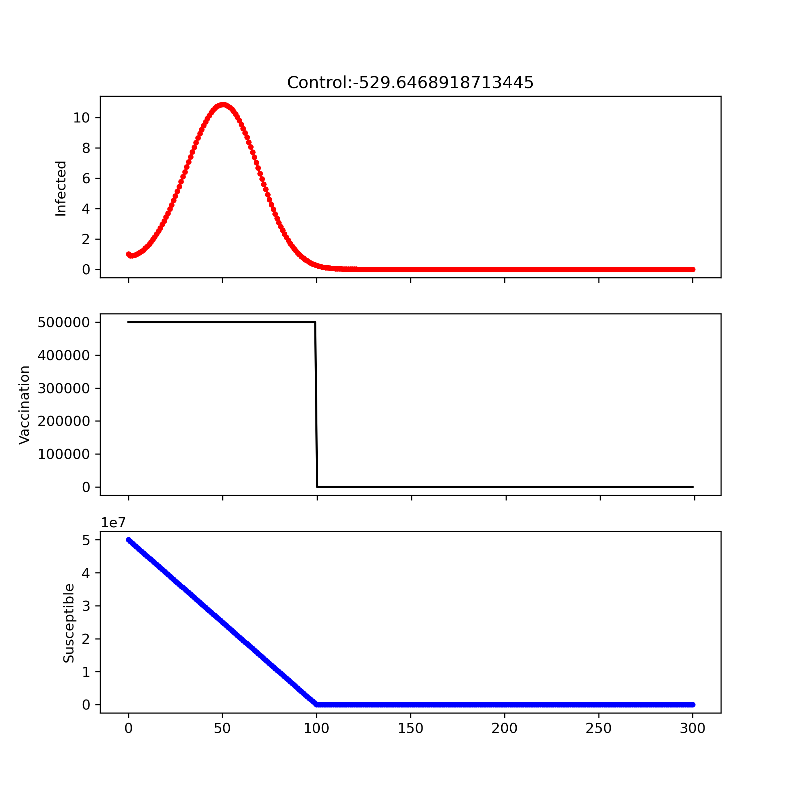
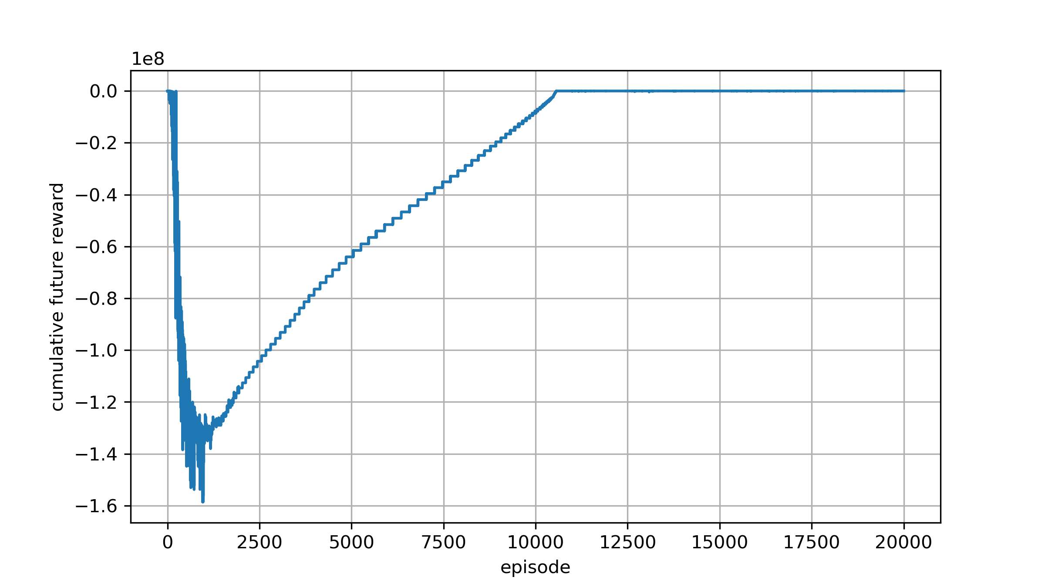
Learning rate : 1e-6 Reward design : −𝑰
Reward : $`−I`$

Slide 5

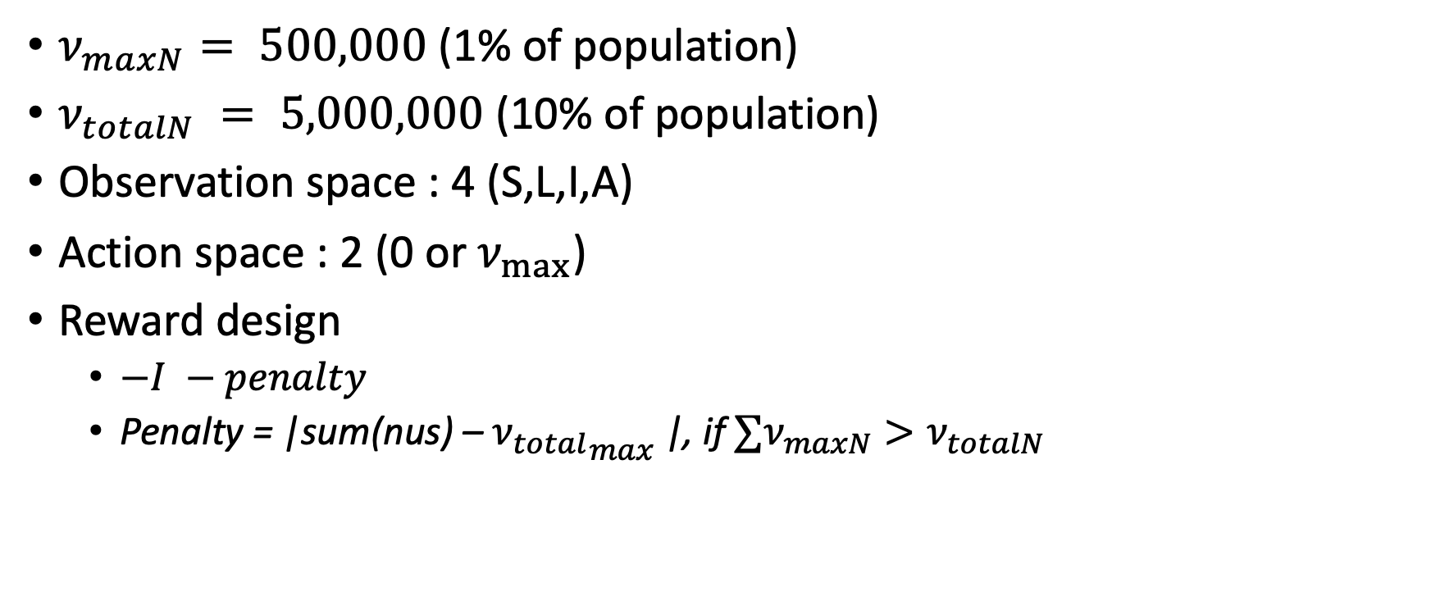
Set the environment for DQN in SLIAR
Reward : $`−I−penalty`$
$ν_{maxN}⁡= 500,000$ (1% of population)
$ν_{totalN} = 5,000,000$ (10% of population)
Observation space : 4 (S,L,I,A)
Action space : 2 (0 or $ν_{max}$)
Reward design
$−I −penalty$
Penalty = |sum(nus) – ${ν_{total}}_{max}$|, if $∑ν_{maxN}>ν_{totalN}$

Slide 6
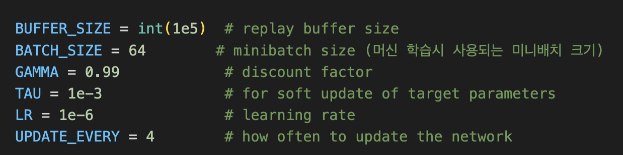
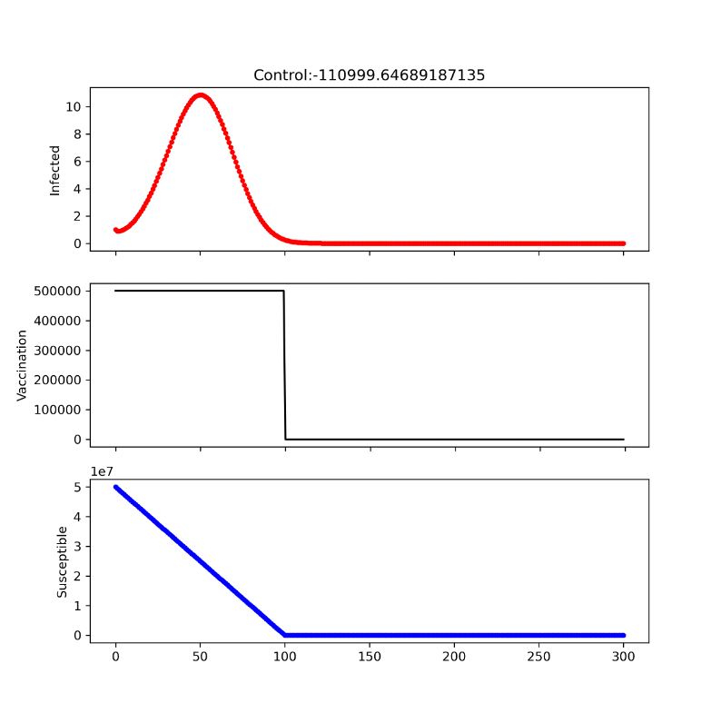

Experiment1
Reward : $`−I−penalty`$

Slide 7
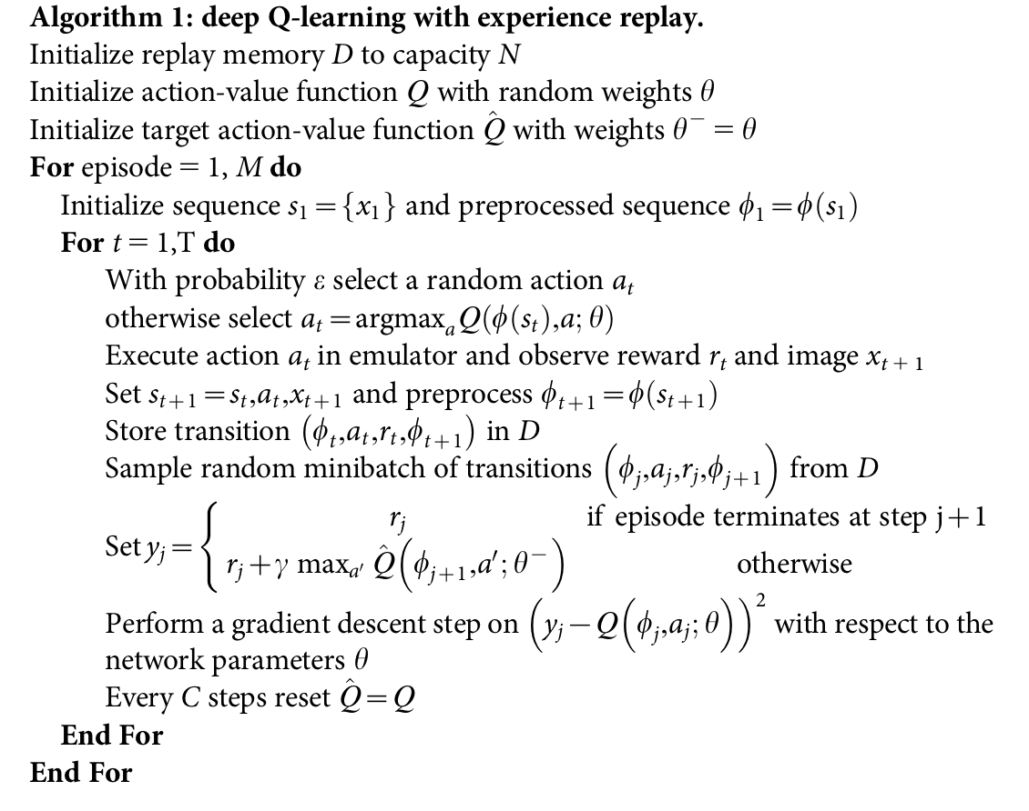
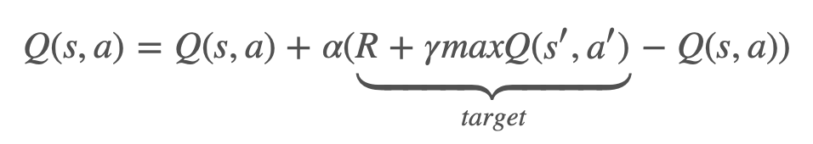


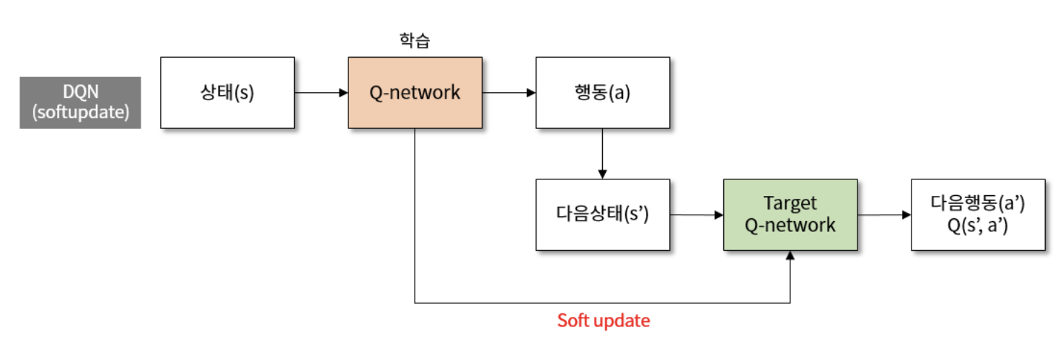
DQN algoritm
Hyperparameter related to learning performance
Replay buffer size : 머신 기억용량
현재 : 1e5 (1e5개 까지만 저장)
Time step : 300 * episode 20000
Q Network initial setting
Learning rate
Soft update

Slide 8
DQN algoritm
Hyperparameter related to learning performance
Replay buffer size : 머신 기억용량
현재 : 1e5 (1e5개 까지만 저장)
Time step : 300 * episode 20000
Q Network initial setting
Learning rate
Soft update

Slide 9
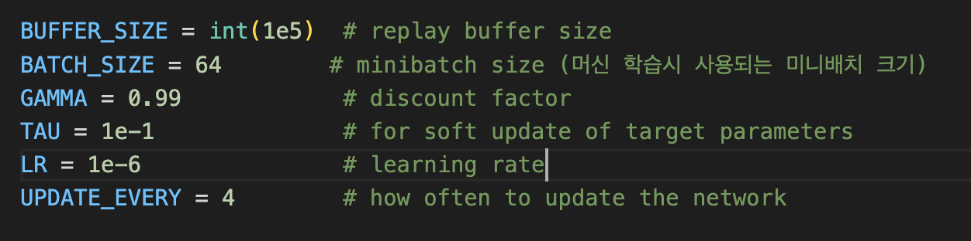

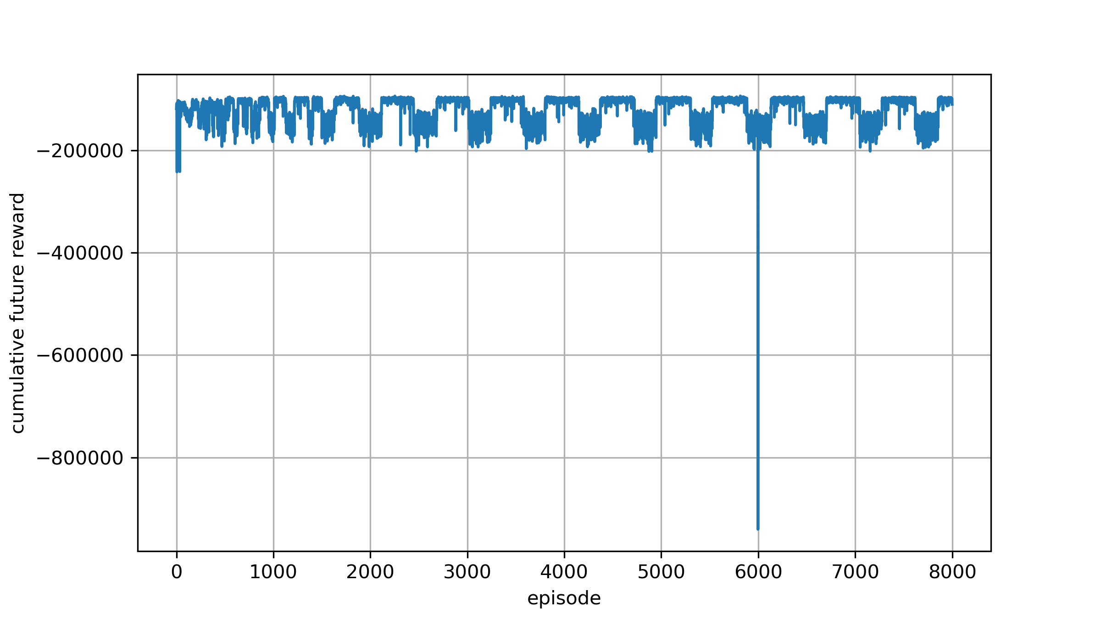
Experiment2 Change the softupdate rate
Reward : $`−I−penalty`$

Slide 10
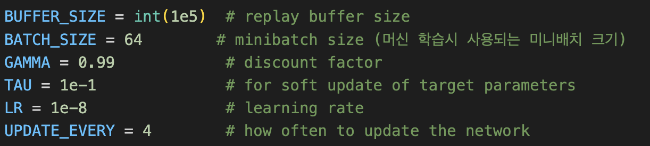
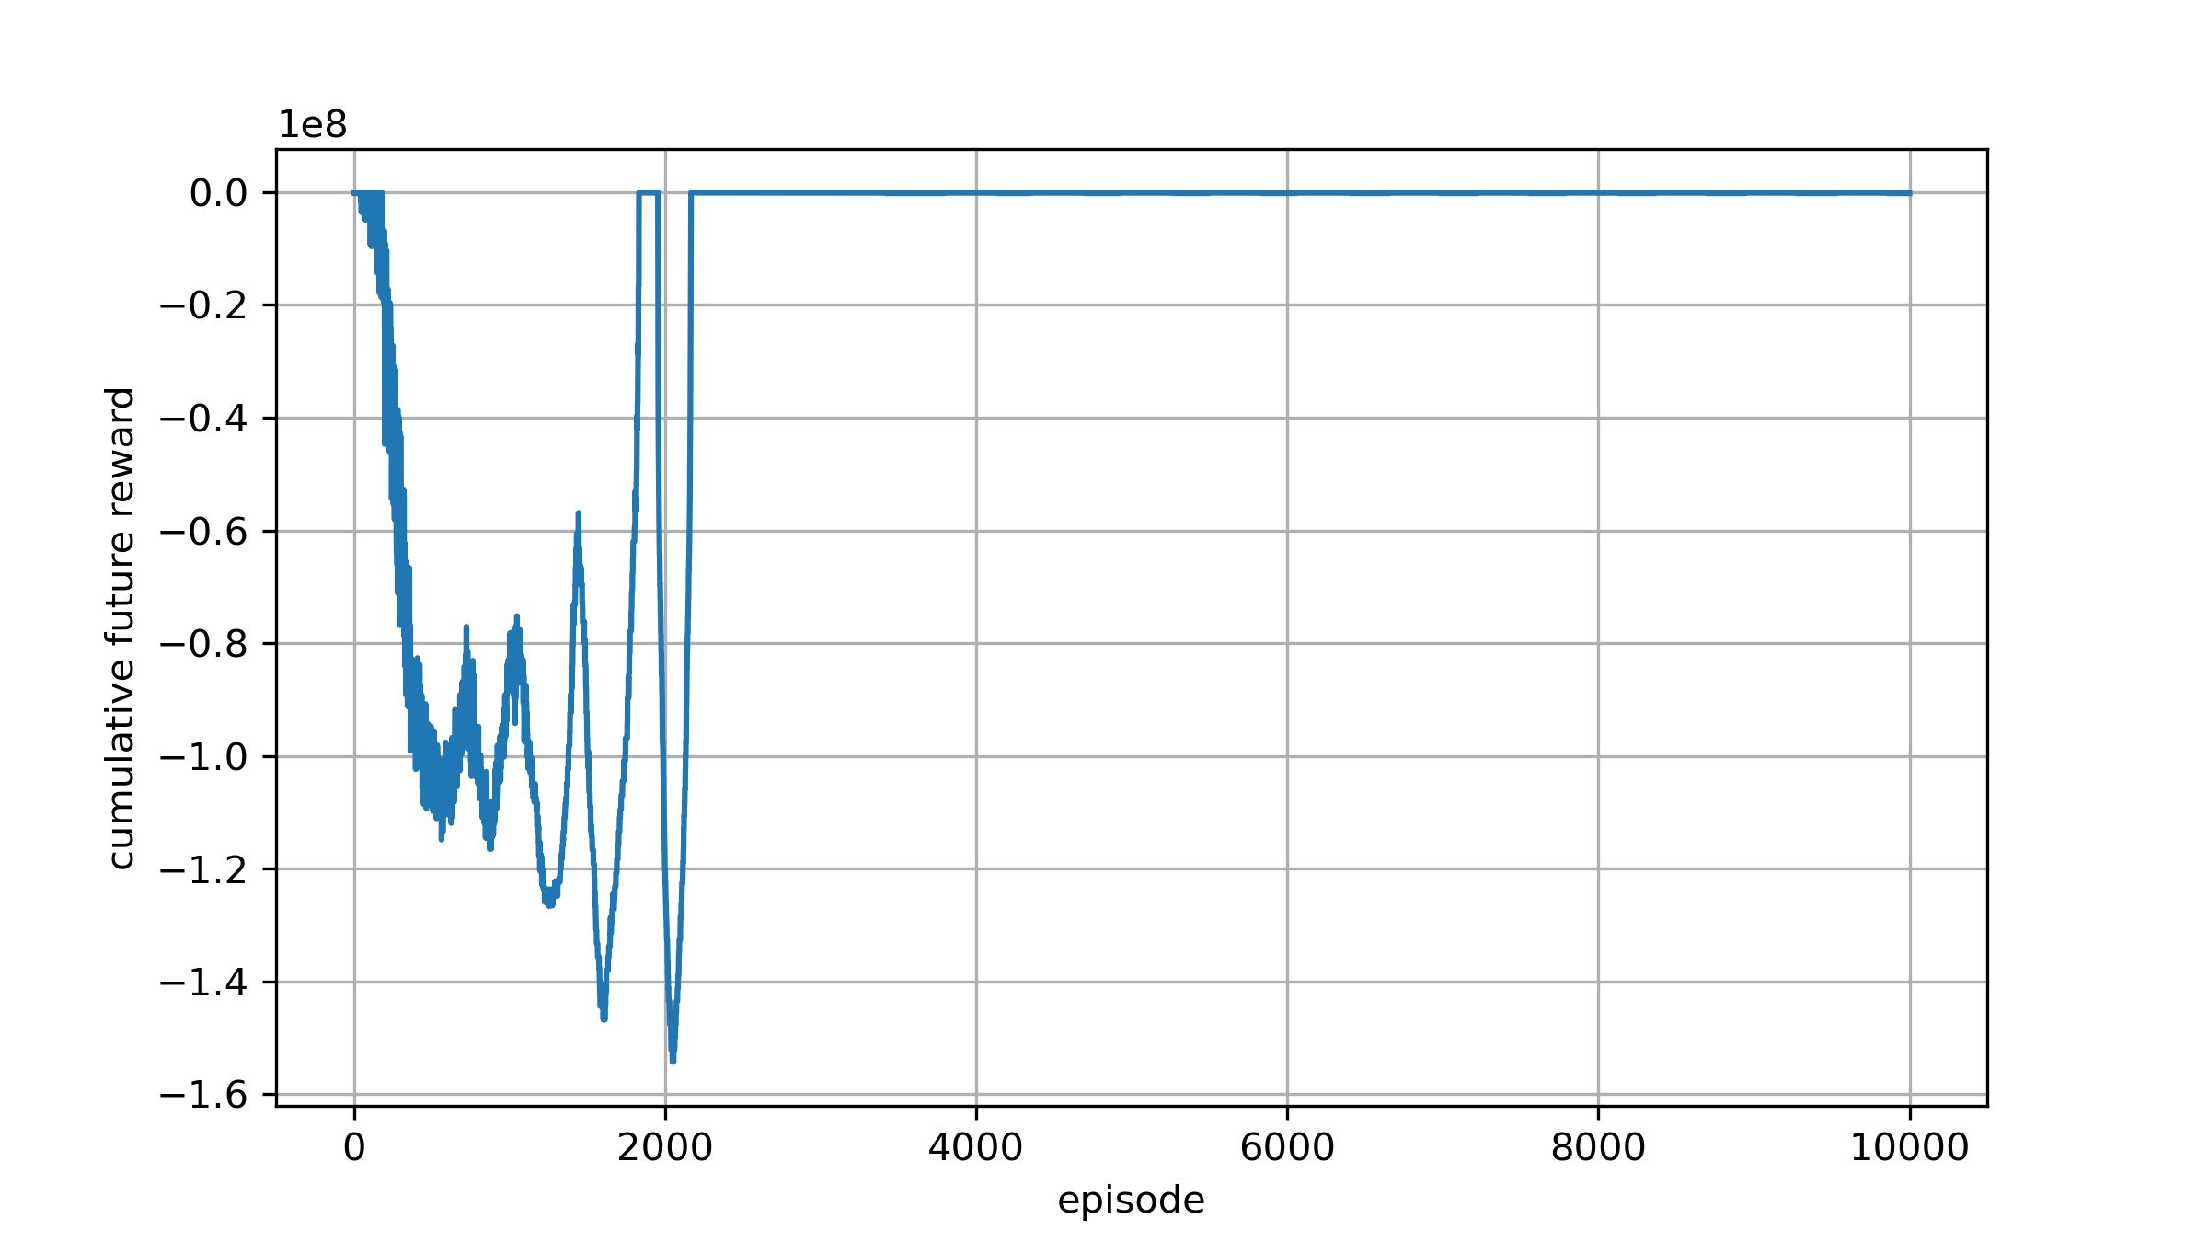
Experiment3 Change the softupdate rate
Reward : $`−I−penalty`$

Slide 11
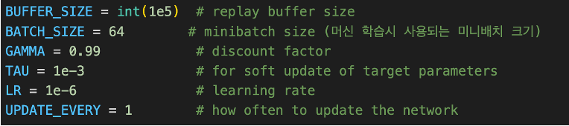
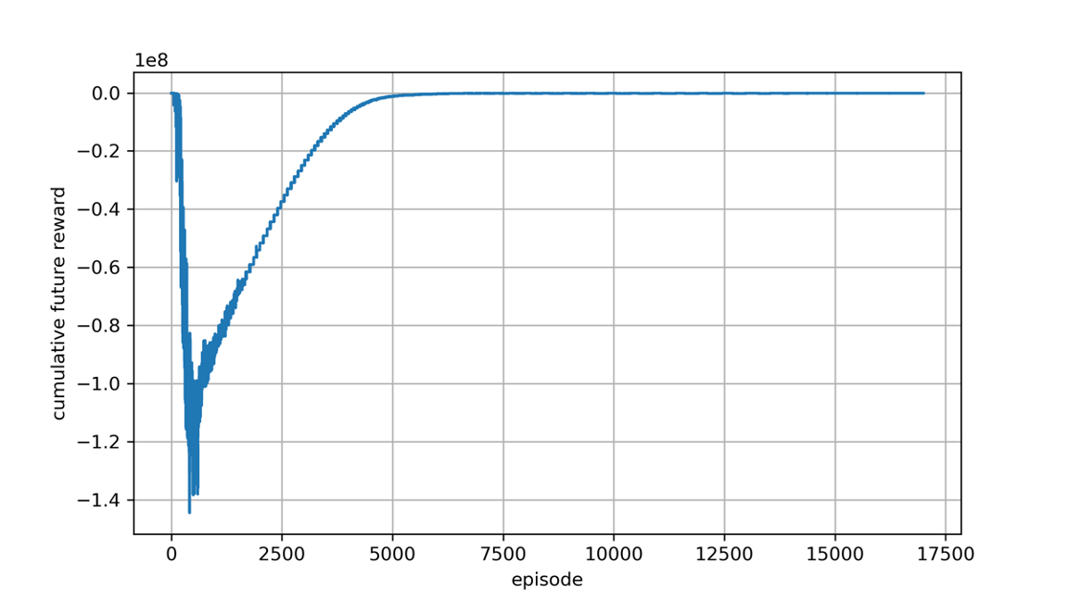
Experiment4 Change the softupdate period
Reward : $`−I−penalty`$

Slide 12
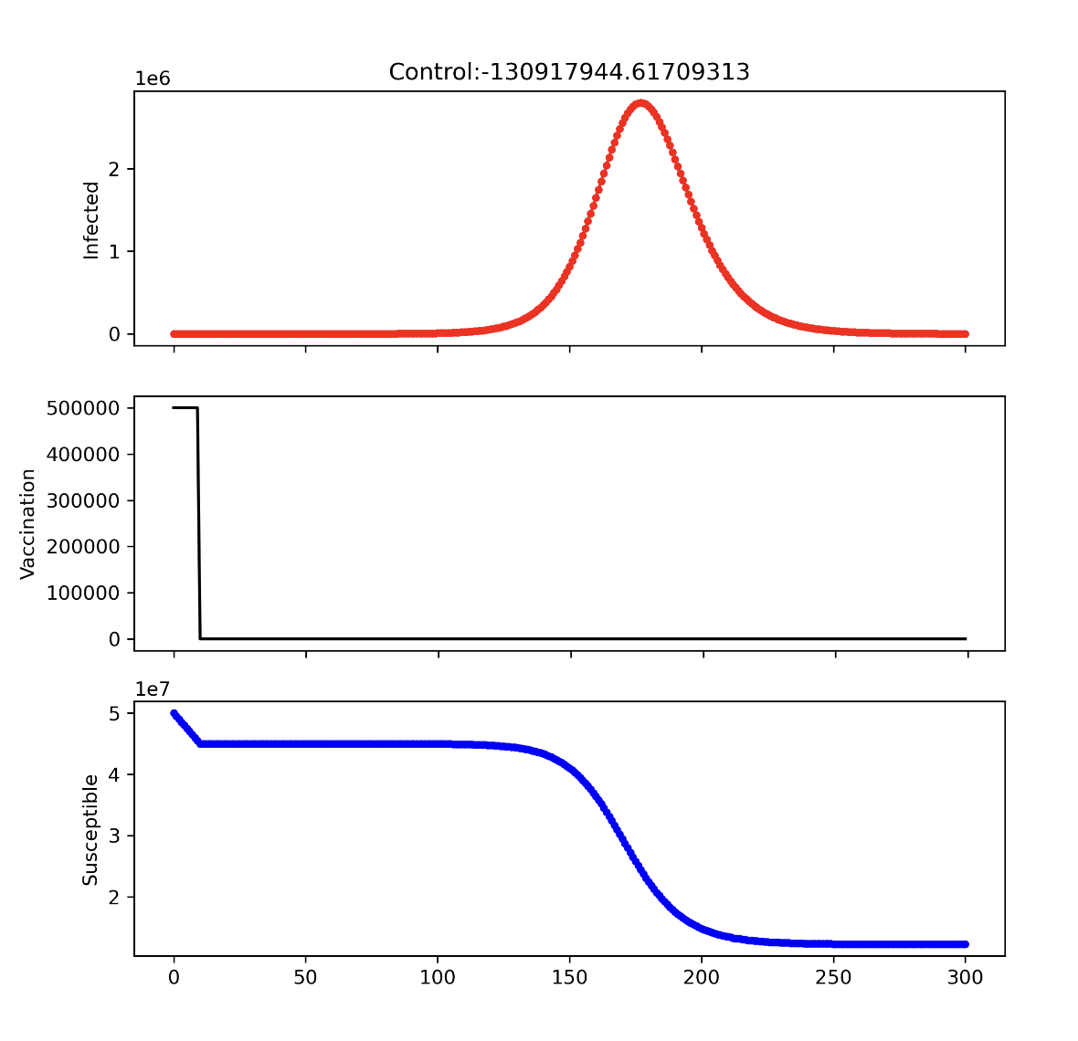
If nu vaccination : 10days

Slide 13
Next Todo
최소가 되는 nu vaccination 확인!
Q-Network
Initial setting - ‘He’ Initialization (relu 특화)
Initial setting - ’Grolot’ Initialization (tanh, sigmoid)
Replay buffer size and batch size check

